Slide 1

11/29 台北，12/06 高雄，12/20 台中

Slide 2

簡報檔與範例程式下載說明
小朱
MS MVP on Windows Azure
台灣微軟資深講師

Slide 3
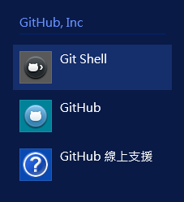
安裝 Git for Windows
下載：http://windows.github.com/
ClickOnce 方式安裝，無須太多的設定。

Slide 4
下載範例程式碼
啟動 Git Shell
為範例程式建立新目錄
同步 Git Repository
必須要在範例程式的目錄內下載。
git clone https://github.com/regionbbs/msrwdseminar201312.git

Slide 5
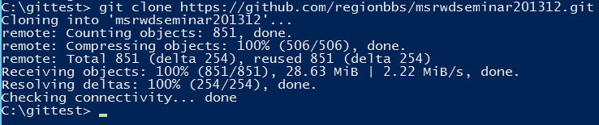
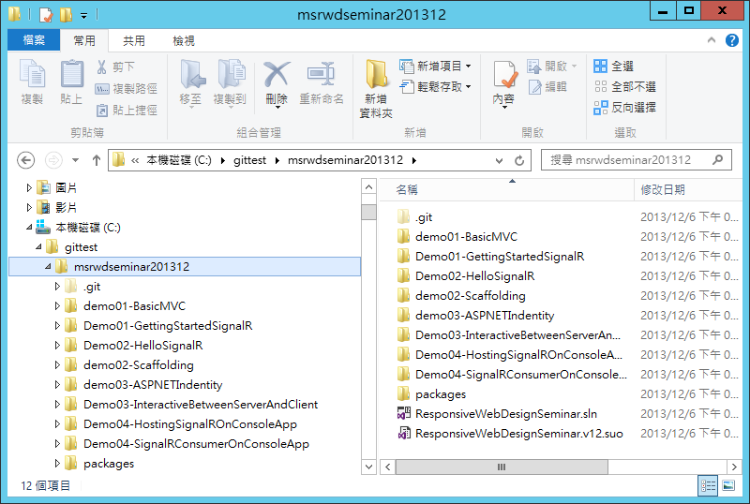

Slide 6

© 2013 Microsoft Corporation. All rights reserved. Microsoft, Windows and other product names are or may be registered trademarks and/or trademarks in the U.S. and/or other countries.
The information herein is for informational purposes only and represents the current view of Microsoft Corporation as of the date of this presentation. Because Microsoft must respond to changing market conditions, it should not be interpreted to be a commitment on the part of Microsoft, and Microsoft cannot guarantee the accuracy of any information provided after the date of this presentation. MICROSOFT MAKES NO WARRANTIES, EXPRESS, IMPLIED OR STATUTORY, AS TO THE INFORMATION IN THIS PRESENTATION.

